Slide 1

Adaptive Purchase Planner (APP)
Team James – Sakina Vohra, Jiajin Zhao, Sen Yan, Rohan B, Eoin Roche, Nikhil Girraj

Slide 2

the Idea
Application that suggests daily goods that the users would buy.
Personalized purchase suggestions based upon
User’s location
Buying behavior from previous purchases
Further purchase suggestions based upon other users’ model
Better deals – learnt from other user’s purchases

Slide 3
Modelling Approaches
Basic user characteristics will be asked explicitly. This includes
Age / age group
Gender
Household size
Adaptation effect will be based on implicit learnings based on purchase data
Entered either through scanning a purchase receipt
Manual entry
Stereotyping based on data from other users with similar purchase history
What is learnt as part of the model –
Preferred shopping locations
Frequency of buying certain products

Slide 4
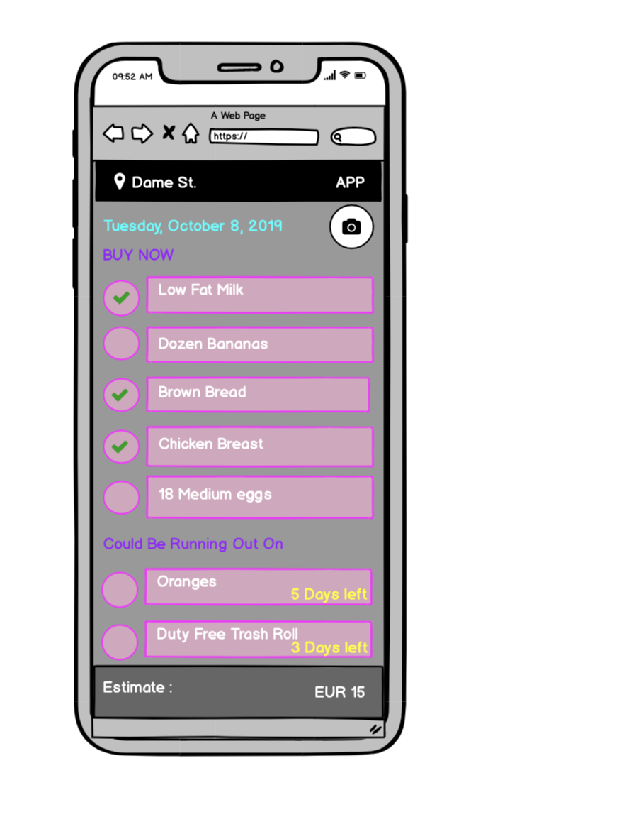
Vision so far…
Buying behavior is learnt by either –
Scanning receipt of a completed purchase
Manual entry
Suggestions can be either removed completely to modify user model
Phone app (stretch goal) –
User is notified of potential buying options based on location

Slide 5
Proposed Technologies
Python (Django)
Angular for UI
SQL DB
Google Cloud Vision API

Slide 6

Questions?

